Slide 1

An introduction to statistics
Lecture 6 (probability)
By/ aly maher abdelfattah

Slide 2
Important Terms
Probability: the chance that an uncertain event will occur (always between 0 and 1)
Experiment: a process of obtaining outcomes for uncertain events
Elementary Event: the most basic outcome possible from a simple experiment
Sample Space: the collection of all possible elementary outcomes

Slide 3
Important Terms
Random Experiment: It is an experiment so that we know all possible outcomes but we cannot determine which one will occurs exactly. Or it is a chance process that leads to well-defined results called outcomes. (Example: tossing a die)
Sample Space 𝑆: Consists of all possible outcomes of the random experiment. Example: if we toss a die, then 𝑆 = {1,2,3,4,5,6}
Event: Any collection of results or outcomes of a procedure. It is any subset form the sample space 𝑆.
Example: When we toss a coin, let A event we get an even number, then 𝐴 = {2,4,6} ⊂ 𝑆

Slide 4
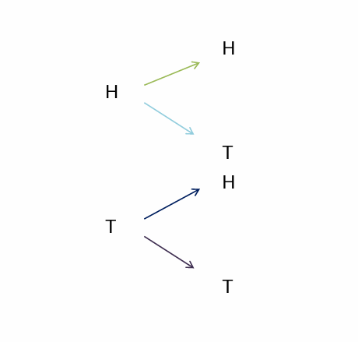
Experiment of tossing a coin two times
Sample space ={(H,H),(H,T),(T,H,),(T,T)}

Slide 5
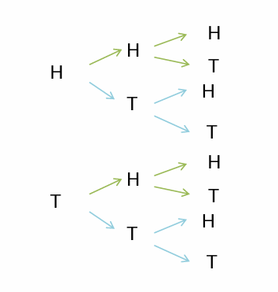
Experiment of tossing a coin two times
Sample space={(H,H,H),(H,H,T),(H,T,H),(H,T,T),(T,H,H),(T,H,T) ,(T,T,H),(T,T,T)}

Slide 6

Experiment of rolling a single die
Sample space ={1,2,3,4,5,6}

Slide 7
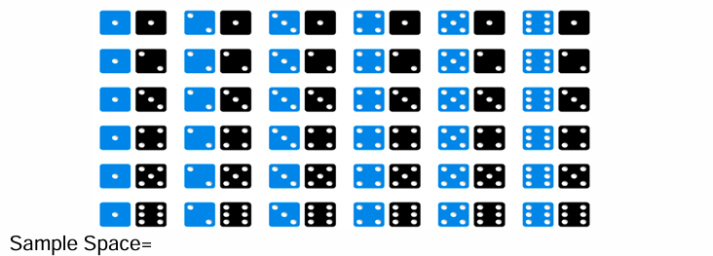
Experiment of rolling a single die
Sample space =
 | 1 | 2 | 3 | 4 | 5 | 6
1 | (1,1) | (1,2) | (1,3) | (1,4) | (1,5) | (1,6)
2 | (2,1) | (2,2) | (2,3) | (2,4) | (2,5) | (2,6)
3 | (3,1) | (3,2) | (3,3) | (3,4) | (3,5) | (3,6)
4 | (4,1) | (4,2) | (4,3) | (4,4) | (4,5) | (4,6)
5 | (5,1) | (5,2) | (5,3) | (5,4) | (5,5) | (5,6)
6 | (6,1) | (6,2) | (6,3) | (6,4) | (6,5) | (6,6)

Slide 8
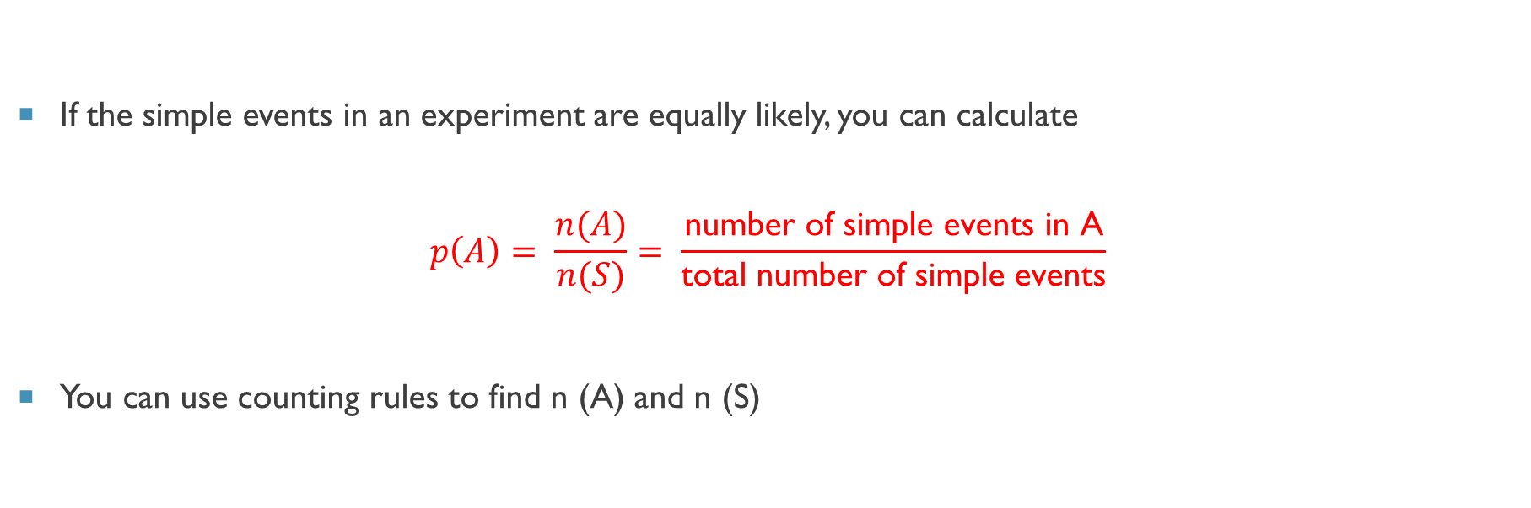
Counting Rules
If the simple events in an experiment are equally likely, you can calculate
$$p\left(A\right)= \frac{n(A)}{n(S)}= \frac{\text{number} \text{of} \text{simple} \text{events} \text{in} \text{A}}{\text{total} \text{number} \text{of} \text{simple} \text{events}}$$
You can use counting rules to find n (A) and n (S)

Slide 9
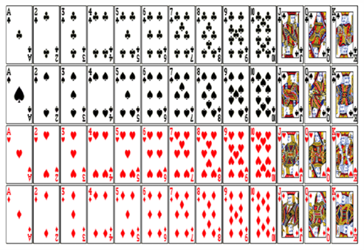
Counting Rules (example)
A card is drawn from a standard deck. Find the probabilities of the following events:
1. Getting king of hearts.
2. Getting a King.
3. Getting a Heart.
4. Getting a face card .

Slide 10
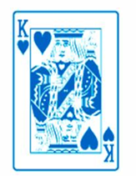
Counting Rules (example)
1 . PROBABILITY OF SELECTING A KING OF HEARTS IS
P(king of hearts is )=1/52

Slide 11
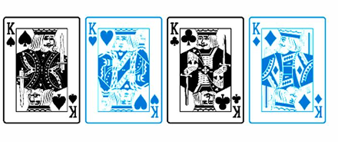
Counting Rules (example)
2 . PROBABILITY OF SELECTING A KING IS
P(king)= 4/52= 1/13

Slide 12
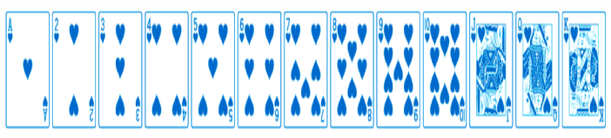
Counting Rules (example)
3 . PROBABILITY OF SELECTING A HEART IS
P(Heart)=13/52

Slide 13
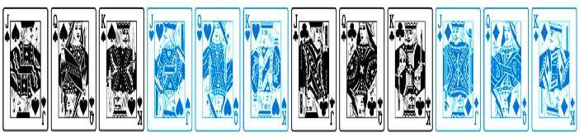
Counting Rules (example)
4 . PROBABILITY OF SELECTING A FACE CARD IS
P(face card )=12/52

Slide 14
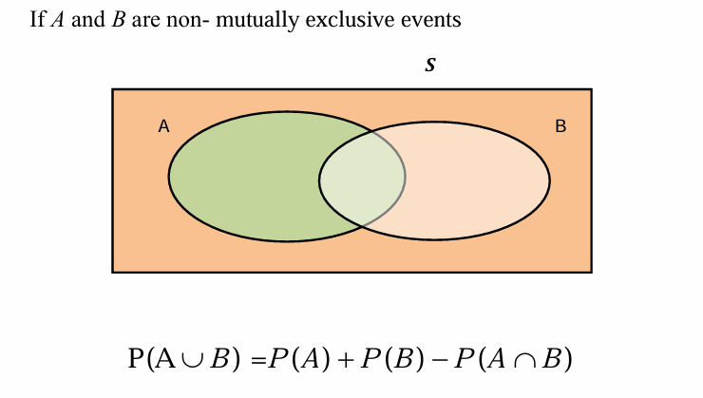
The General Addition Rule

Slide 15
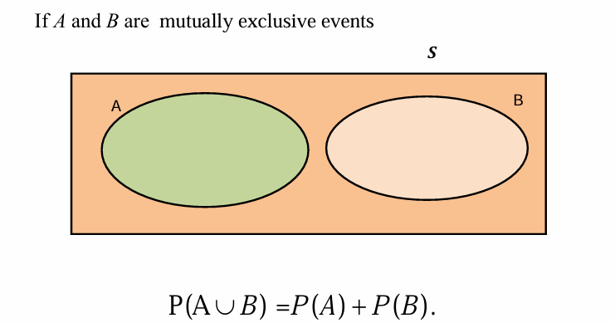
Special Rule of addition Rule

Slide 16
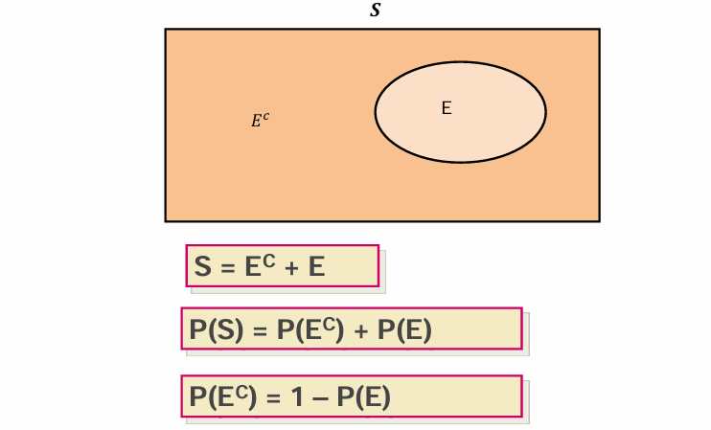
An event and its complement

Slide 17
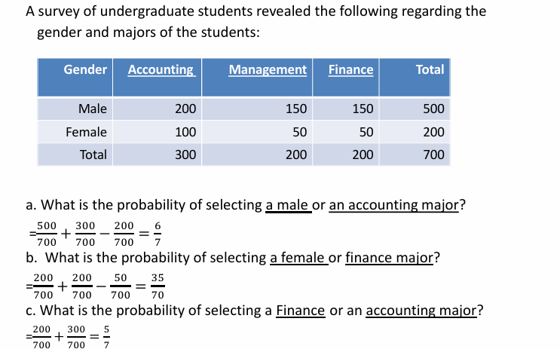
Example:

Slide 18
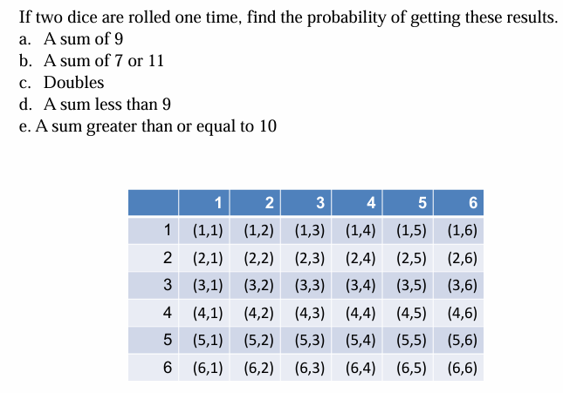
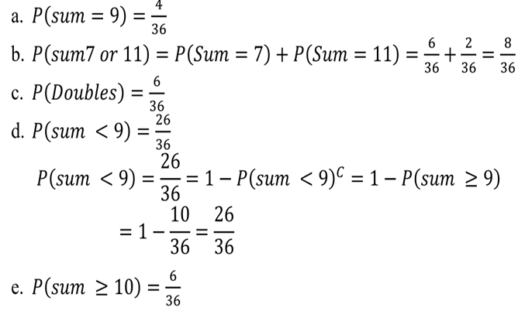
Example:

Slide 19
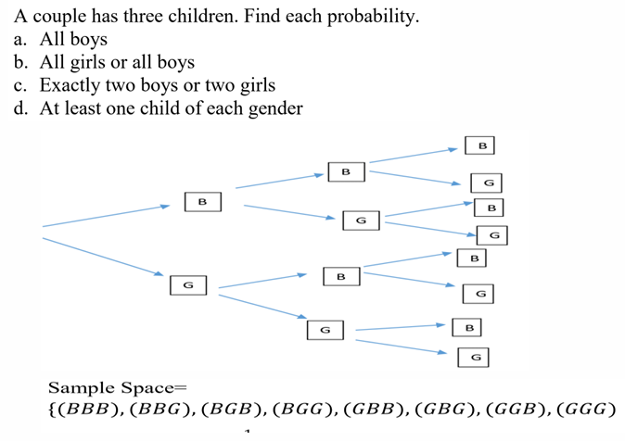
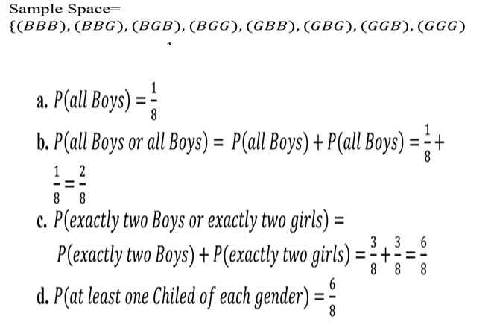
Example:

Slide 20
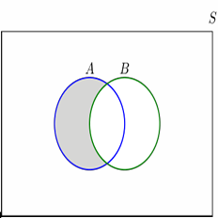
Subtraction (A-B)
𝐴−𝐵= event that A occurs and B not occurs at the same time.
It consist of the elements of A after excluding the elements of B
Example: if 𝐴 = 1,3,5 and 𝐵 = {4,5,6} then 𝐴 −𝐵 = {1,3}
𝑃 (𝐴 − 𝐵) = 𝑃(𝐴) − 𝑃 (𝐴∩𝐵)
𝑃 (𝐵 − 𝐴) = 𝑃(𝐵) − 𝑃 (𝐴∩𝐵)

Slide 21
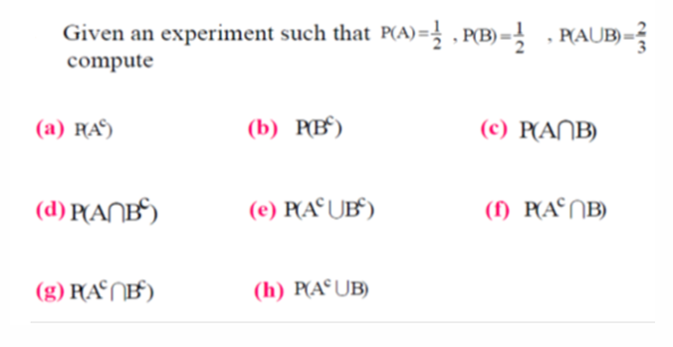
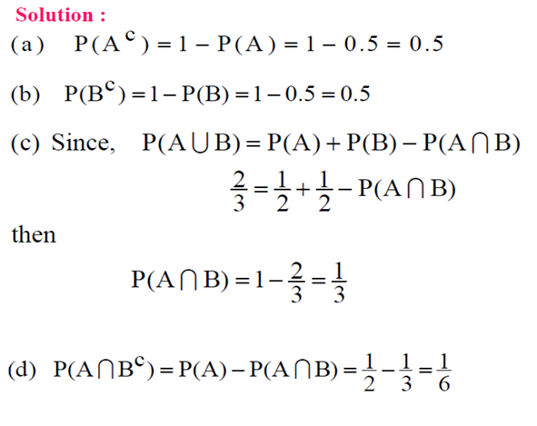
Some important rules

Slide 22
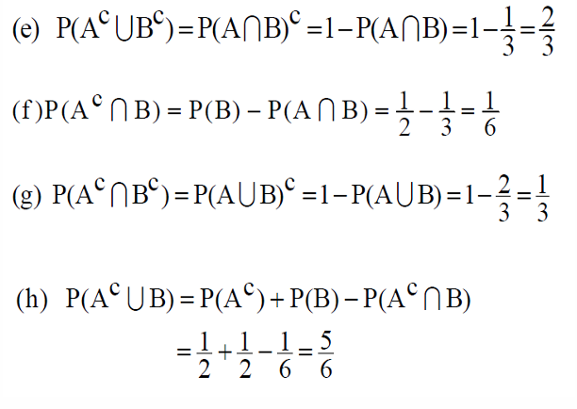
Some important rules

Slide 23
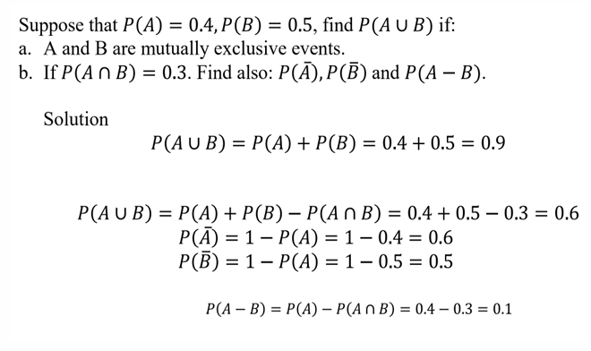
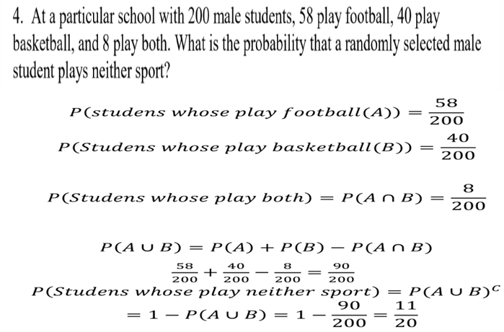
Some important rules

Slide 24

Thank you

